Slide 1
CS 416 Web Programming Javascript wrap up
Dr. Williams
Central Connecticut State University

Slide 2
Review from last class
Forms and submission
Write a form that has a textbox and a submit button
On submit the form should be posted to response.jsp
At submit the form should check
that at least 2 words were entered
The first character of the second word can not be a “4”
If either of the conditions fail the form should not post

Slide 3
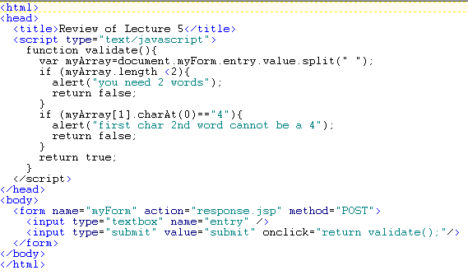
Possible solution

Slide 4
Topics for wrap up
Javascript files and libraries
Jquery

Slide 5
Javascript extract source
Best practice
BODY < HEAD defined < Separate source file
Reason is usability
In BODY use where defined
HEAD defined use within page
Separate source can be used throughout site

Slide 6
Separate source inclusion
Standard within “js” directory
Define file with “.js” extension, all content interpreted as javascript
Within page include file within HEAD of document
<script src="js/MyScriptFile.js" type="text/javascript" > </script>
Code can then be referenced just as if it was defined in page

Slide 7
JQuery
Source file just like one you would develop, but reference via where defined:
Either via library on web, or imported on your server
Via web, ex.
<script src="https://ajax.googleapis.com/ajax/libs/jquery/1.11.3/jquery.min.js">
</script>
Advantage - possibility of bug fixes automatically incorporated
Disadvantage – potential instability if you somehow were dependent on bug
Via site
Import package/source into js directory (functionality built into most development environments)
<script src="js/libs/jquery/jquery.js" type="text/javascript"></script>

Slide 8
What is JQuery?
Feature rich JavaScript library
Tag manipulation
Event handling
Animation (i.e. adding some flash to website)
Ajax integration
Many JavaScript libraries out there feel free to explore, this one most used
88% of all sites that use javascript libraries
Next closest MooTools less than 9%

Slide 9
JQuery class goals
Simply put it can do a ton of things to give your site the look and feel you want – highly encourage you to explore, however…
Goal of class is to go into design of successful web architecture so we will just skim surface

Slide 10
JQuery basics – syntax and selectors
Coded anywhere you have Javascript, but different syntax starting with $ sign
Specify element you want to apply code to:
Select all tags of a specified type:
$("p")
Elements with specified id:
$(“#myId”)
Elements with specified class:
$(“.myclass”)
All INPUT elements of type…
$(“:button”)
Current element
$(this)
All elements
$(“*”)

Slide 11
JQuery events
Lots of events available, arguably much easier than coding events directly in HTML – big advantage is can be reused across site
General syntax is element(s) you want to capture event for, event, code to run:
selector.event(javascript function defn to execute)
$(“h1”).click(function(){
alert(“You clicked me!”);
$(this).hide();
});

Slide 12
Most common events
click
dblclick
hover
Forms
focus (form element selected)
blur (form element loses focus)
submit

Slide 13
Common “Flashy” elements
css
$("p").css("background-color", "yellow");
hide/show/toggle
$("#disappearingText").toggle();
fadeIn/fadeOut/fadeToggle
$("#disappearingText").fadeToggle(1000);
animate
$("#calvin").animate({
left: '250px',
height: '+=150px',
width: '+=150px'
});
});

